Slide 1
Computer Programming
Introduction to Computer Programming with Scratch

Slide 2
Do you know how a programs works?
Yes
No

Slide 3
Do you know what Scratch is?
Website
Program
Game

Slide 4
Using Scratch
Let’s get to know Scratch!

Slide 5
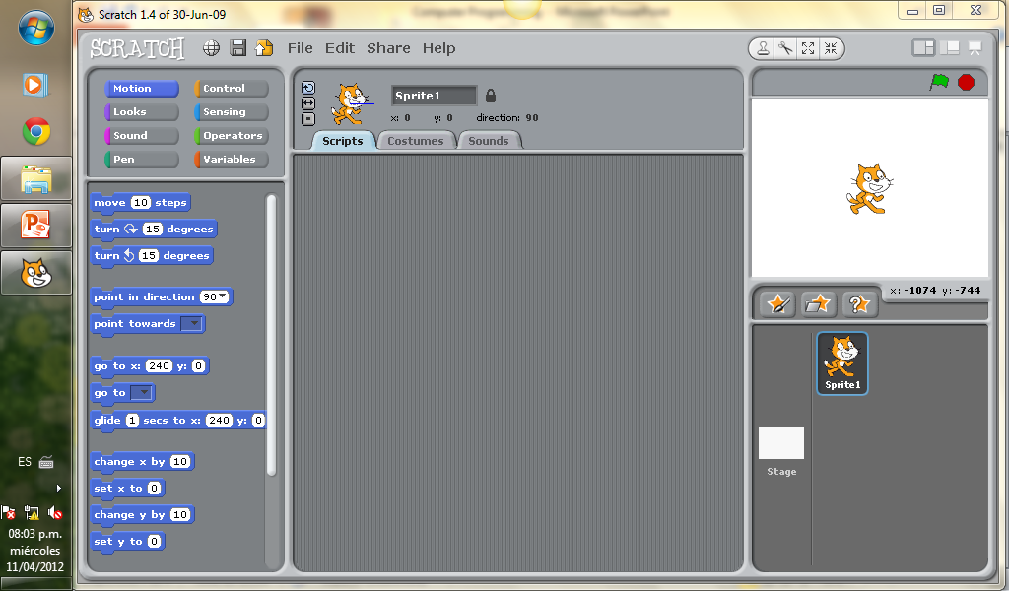

Slide 6
The actors in our program are called:
Puppets
Pets
Sprites

Slide 7
The place where the sprites move is called the:
Stage
Script
Land

Slide 8
Simple Commands
Exploring Simple Commands
What do they do?

Slide 9
What command makes my sprite move?
1.
Point
Move
Turn
2.
3.

Slide 10
What command makes my sprite turn right?
1.
Point
Move
Turn
2.
3.

Slide 11
This command turns my sprite to the:
Right
Left

Slide 12
What command makes my sprite point to a direction?
1.
Point
Move
Turn
2.
3.

Slide 13
Sequence of Commands
Sometimes we want to do several actions in a row.

Slide 14
Do the command sequences do the same?
Yes
No

Slide 15
Do the command sequences do the same?
Yes
No

Slide 16
Sequence of Commands
Try making a sequence to draw a square!

Slide 17
Was it hard to put the right commands to draw a square?
Yes
No

Slide 18
Do you see repeated commands to draw a square?
Yes
No

Slide 19
Introduction to Iteration
Why repeat when you can iterate!

Slide 20
How many times should our repeat block have to draw a square?
6 times
3 times
4 times

Slide 21
Introduction to Iteration
Experiment with different angles and sequences of commands.

